Slide 1


Report on exit task on ETL module
Viltaliya Adamchuk
Business Intelligence lab
December 2, 2017

Slide 2
Main features of the business description
EquipNet is the world’s most comprehensive surplus asset management company. EquipNet, Inc. is the world leader in proactive asset management services and solutions for large and small corporations alike. It specializes in the pharmaceutical, biotech, chemical, semiconductor, aerospace, automotive, and consumer packaged goods industries, as well as many other markets. EquipNet’s vision is to revolutionize the way companies manage their surplus assets. Forward-thinking corporations such as Merck, Johnson & Johnson, Unilever, Novartis and many others use EquipNet's Cascading Model™ to maximize financial returns, meet critical deadlines, avoid unnecessary costs, and prevent health, environmental, and theft hazards associated with idle assets.
Business process
Business process are sales among regions in the sphere of office equipment and incoming goods.
Grain
Grain shows information about sold product (order time, quantity, ship mode etc.)

Slide 3
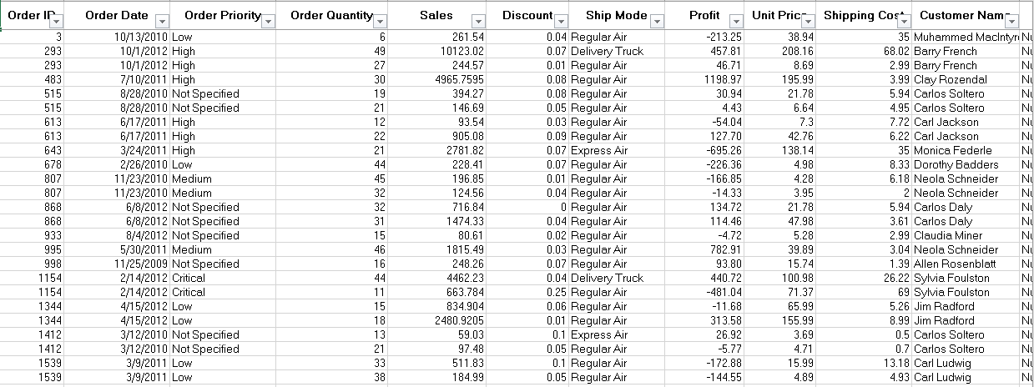
Source data
Notes:
P37 – divide into 2 slides

Slide 4
Source data
Notes:
P37 – divide into 2 slides

Slide 5
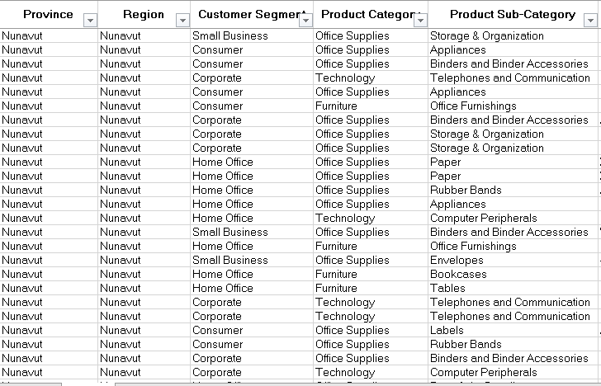
Source data
Notes:
P37 – divide into 2 slides

Slide 6
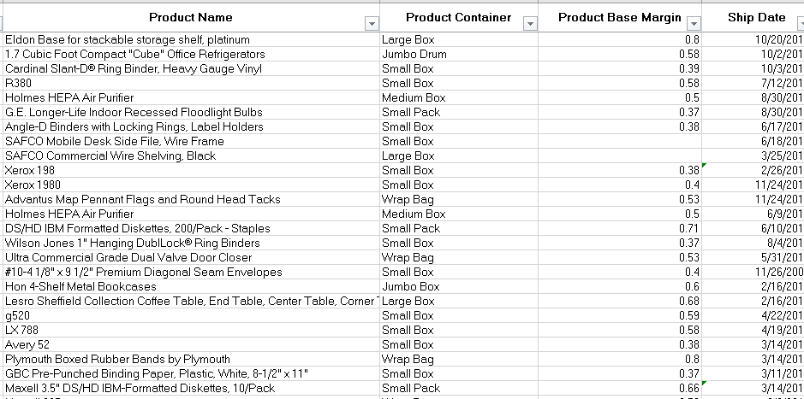
Source data
Notes:
P37 – divide into 2 slides

Slide 7
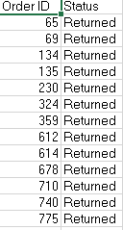
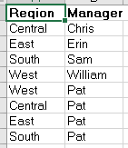
Source data
Notes:
P37 – divide into 2 slides

Slide 8
DATA FLOW
FLAT FILE | SA_SRC | BL_CL | BL_3NF | BL_DM
Source data
Externa tables in one entity with source data
Work tables according to the source
Cleaned tables according to the 3nf schema. Without any primary keys
Tables resembling cleaned tables from BL_CL, with generated primary keys
Tables (dimensions) which categorizes fact and measures in order to enable users to answer business questions
Fact table, based on the grain of business process (Orders)

Slide 9
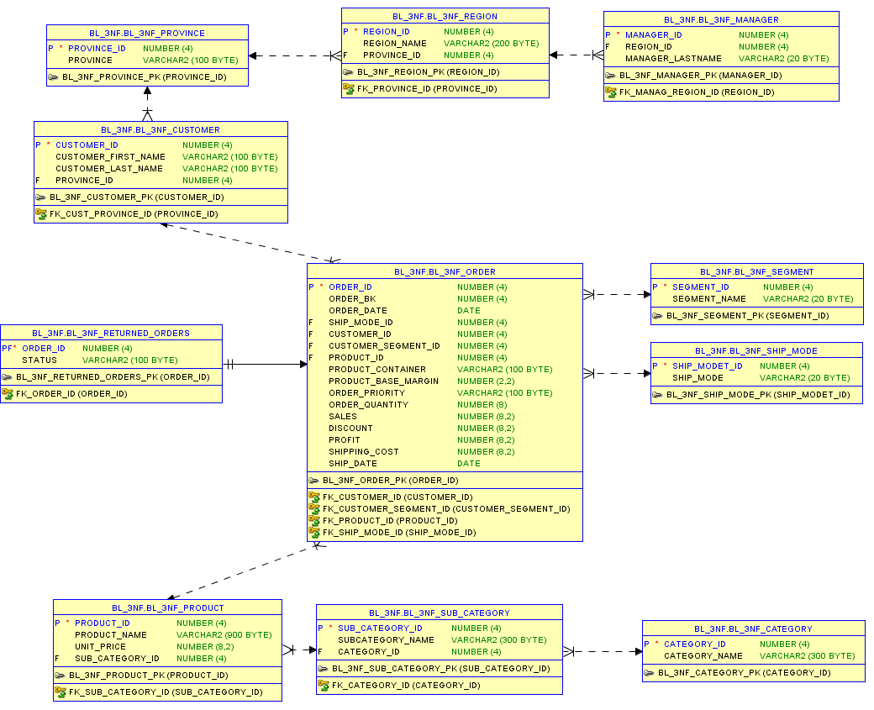
3NF Model

Slide 10
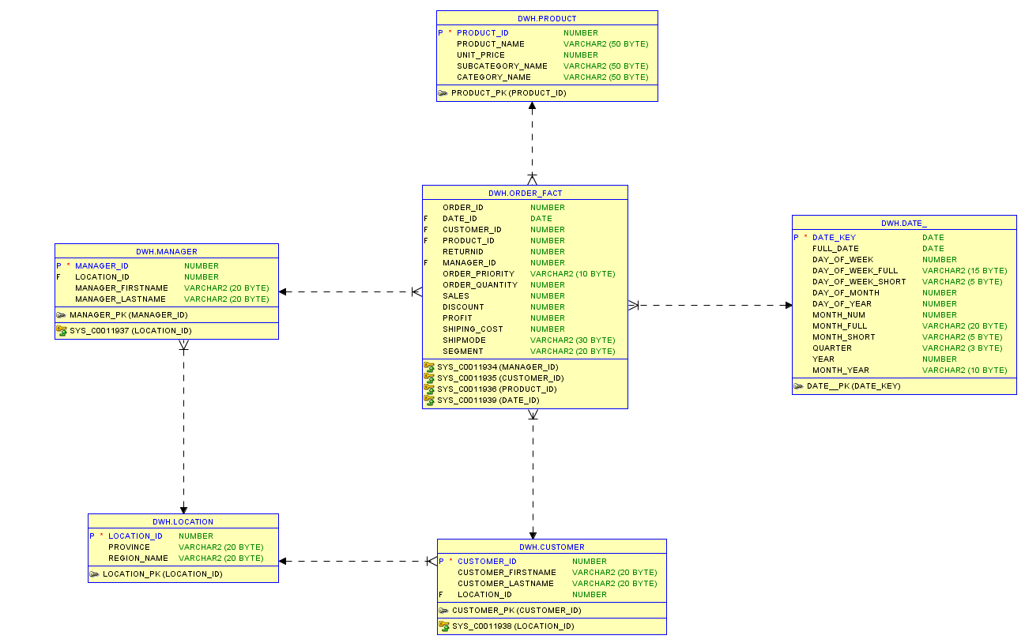
Logical Model Snowflake

Slide 11
Benefits of the Snowflake logical model
1
Some OLAP multidimensional database modeling tools are optimized for snowflake schemas.
2
Normalizing attributes results in storage savings, the tradeoff being additional complexity in source query joins.

Slide 12
Common package to organize the data migration SA_SRC→BL_CL_WRK
CREATE OR REPLACE PACKAGE WRK_INSERT_PKG AS
PROCEDURE WRK_INSERT (EXT_TABLE_NAME IN VARCHAR2, WRK_TABLE_NAME IN VARCHAR2);
END; /
CREATE OR REPLACE PACKAGE body WRK_INSERT_PKG AS
PROCEDURE WRK_INSERT (EXT_TABLE_NAME IN VARCHAR2, WRK_TABLE_NAME IN VARCHAR2)AS
BEGIN
EXECUTE IMMEDIATE 'INSERT INTO '||WRK_TABLE_NAME||' SELECT * FROM '|| EXT_TABLE_NAME;
END;
END WRK_INSERT_PKG; /

Slide 13
Common MERGE to organize data migration BL_CL→BL_3NF
MERGE INTO bl_3nf.TABLE_NAME1 TN1
USING ( SELECT COLUMN1, COLUMN2 FROM bl_cl.table_name2) tn2
ON (TN1.KEY = tn2.key)
WHEN MATCHED THEN
UPDATE SET tn1.column1 = tn2.column1, tn1.column2 = tn2.column2 WHERE
decode(tn1.column1, tn2.column1,0,1)+decode(tn1.column2, tn2.column2,0,1)>0
WHEN NOT MATCHED THEN
INSERT (tn1.column1, tn1.column2)
VALUES (tn2.column1, tn2.column2);

Slide 14
Generating date dimension
insert into date_ select 10000+level as date_id, to_date('31/12/2009','dd.mm.yyyy') + numtodsinterval(level,'day') as full_date, to_number(to_char(to_date('31.12.09','dd.mm.yyyy') + numtodsinterval(level,'day'), 'd')) as day_week, to_char(to_date('31.12.09','dd.mm.yyyy')+ numtodsinterval(level,'day'),'day', 'nls_date_language=russian') as day_week_name, to_number(to_char(to_date('31/12/2009','dd.mm.yyyy') + numtodsinterval(level,'day'), 'dd')) as day_month, to_number(to_char(to_date('31/12/2009','dd.mm.yyyy') + numtodsinterval(level,'day'),'ddd')) as day_year, to_number(to_char(to_date('31/12/2009','dd.mm.yyyy') + numtodsinterval(level,'day'),'mm')) as month_num, to_char(to_date('31/12/2013','dd.mm.yyyy') + numtodsinterval(level,'day'), 'month', 'nls_date_language=russian') as month_name, to_number(to_char(to_date('31/12/2009','dd.mm.yyyy') + numtodsinterval(level,'day'), 'Q')) as quarter, case when to_char(to_date('31/12/2009','dd.mm.yyyy') + numtodsinterval(level,'day'),'MM')<'07' then 1 else 2 end as half_year, to_number(to_char(to_date('31/12/2009','dd.mm.yyyy') + numtodsinterval(level,'day'),'YYYY')) as year from dual connect by level < 10000 ;

Slide 15
Benefits of implementing DWH
DWH will be build to enable store managers to create effective staff schedules that increase productivity and motivation. This DWH will help store managers stay focused on what’s most important to them: their customers and their teams. Other benefits of implementing DWH are:
Data retrieval is faster within data warehouses
Prior to loading data into the data warehouse, inconsistencies are identified and resolved.
Data warehouses can work in conjunction with and, hence, enhance the value of operational business applications, such as, for example, CRM systems.

